Slide 1
DAEN 690 – Capstone – Team Autoencoders
Summer 2020 – Section 002

Slide 2
Autoencoders - mid-Sprint -3.1 – analytic/algorithm
June 7, 2020

Slide 3
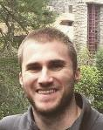
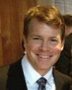

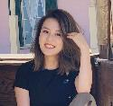
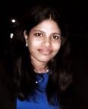
Team autoencoders - Members
Matt Machado
Product Owner
Stephen Schade
SCRUM Master
Yun Li
Developer
Jun Wang
Developer
Gauthami Kuravi
Developer

Slide 4
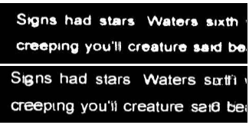
Team autoencoders – problem statement
Problem Context:
Domain of problem: OCR technology is valuable in any instance where documents or images have text, such as healthcare, banking, manufacturing, legal, business, and other industries associated with heave paperwork or documentation.
Importance of problem: Image “noise” is one reason that OCR technology may have trouble reading character text. Removing noise makes OCR more reliable.
Problem Statement: It is difficult to translate text images into text data without some inaccuracies or errors. This project will build a Convolutional Neural Network (CNN) auto-encoder that attempts to reduce image noise during OCR processing. We will evaluate the fidelity of our CNN by conducting OCR text extraction on a dataset before and after the implementation of our method.
Example: Before (top) and after (bottom) OCR denoising

Slide 5
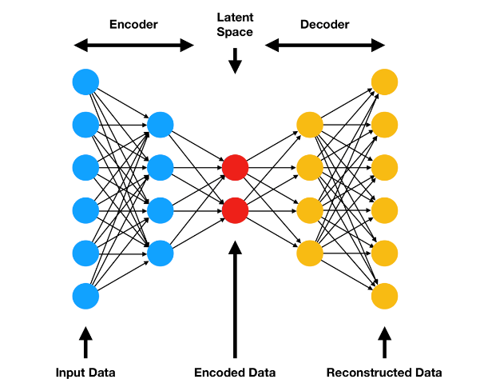
Team autoencoders – Potential Analytics/algorithms
Autoencoder Illustration:

Slide 6
Team autoencoders – Potential Analytics/algorithms
Denoising Process for OCR:
Using PyTesseract to conduct OCR analysis on the chosen dataset and note the according result (such as Accuracy and performance, etc.)
Create the denoising autoencoder by developing CNN algorithms. Train, validate, and test the model until the model satisfies expectations.
Using PyTesseract to conduct OCR analysis with denoising autoencoder created in 2. on the same dataset. Note the according result.
Compare result from 1. and 4. to evaluate how effective the denoising autoencoder is.

Slide 7
autoencoders – Datasets
Datasets Planned for Project
Dataset Name: Ryerson Vision Lab Complex Document Information Processing (RVL-CDIP):
Dataset Owner: Adam W. Harley, Alex Ufkes, and Konstantinos G. Derpanis, stored by Carnegie Mellon’s computer science department.
Dataset Type: Open source, academic computer vision project database
Dataset Size: 37GB
Dataset License: The authors ask that users cite their paper if using this dataset.
A. W. Harley, A. Ufkes, K. G. Derpanis, "Evaluation of Deep Convolutional Nets for Document Image Classification and Retrieval," in ICDAR, 2015
Dataset Location: Web-accessible
Dataset Access: Publicly available.
Dataset Restrictions: None.
Dataset Collection Process: This dataset is a subset of the IIT-CDIP Test Collection, which was used for a 2006 conference paper on complete document information processing. The IIT-CDIP dataset is itself a subset of the Legacy Tobacco Document Library (TLDL), an archive of 14 million documents related to tobacco industry advertising, manufacturing, marketing, scientific research, and political activities.
Analytic/Algorithm that will use dataset: tesseract optical character recognition; convolutional neural network.

Slide 8
Autoencoders – Dataset Quality – Rvl-cdip
Dataset - Ryerson Vision Lab Complex Document Information Processing (RVL-CDIP):
Completeness– 400,000 grayscale images in 16 classes, with 25,000 images per class. There are 320,000 training images, 40,000 validation images, and 40,000 test images.
Consistency – Images are sized so not exceed 1000 pixels for largest dimension.
Uniqueness – All images are unique.
Integrity – All images are .tif(Tagged Image File)
Conformity – All images are stored in a standard format.
Accuracy – Data appears to be accurately managed given the quality of the source.

Slide 9
autoencoders – Dataset Example
Newspaper Clipping
Invoice

Slide 10
Autoencoders – Dataset Issues
Issue 1 – Image files are contained in many different sub folders with 1 image per folder
Mitigation: Write script that extract images files into a more useful structure[Completed]
#2 – Images are in .tif instead of .png or .jpg and may need to be converted
Mitigation: Confirm with sponsor on .tif usefulness in CNN/Autoencoder[Pending]
#3 – Images need to be uploaded into Google Drive for our project and dataset is 37GBs. Google Drive is slow at uploading files.
Mitigation: Find a more efficient way to upload files –OR- reduce dataset into a smaller chunk before uploading[Pending]

Slide 11
Autoencoders – Dataset Issues
#4 – Contains “bad” images that need to be excluded with no clear organization(ie. File folders with 99% noise and no text)
Mitigation – Decipher file coding to remove these files [Completed]
0. letter | 8. file folder
1. form | 9. news article
2. email | 10. budget
3. handwritten | 11. invoice
4. advertisement | 12. presentation
5. scientific report | 13. questionnaire
6. scientific publication | 14. resume
7. specification | 15. memo

Slide 12
autoencoders- Preprocessing of images
Preprocessing of images
OpenCV library in Python
Different methods can come in handy with different kinds of images.
Pytesseract is a wrapper for Tesseract-OCR Engine. It is also useful as a stand-alone invocation script to tesseract, as it can read all image types supported by the Pillow and Leptonica imaging libraries, including jpeg, png, gif, bmp, tiff, and others
Preprocessing for Tesseract:
Gray scaling
Reshaping
thresholding
opening
canny edge detection
noise removal
Whitelisting characters
Blacklisting characters

Slide 13
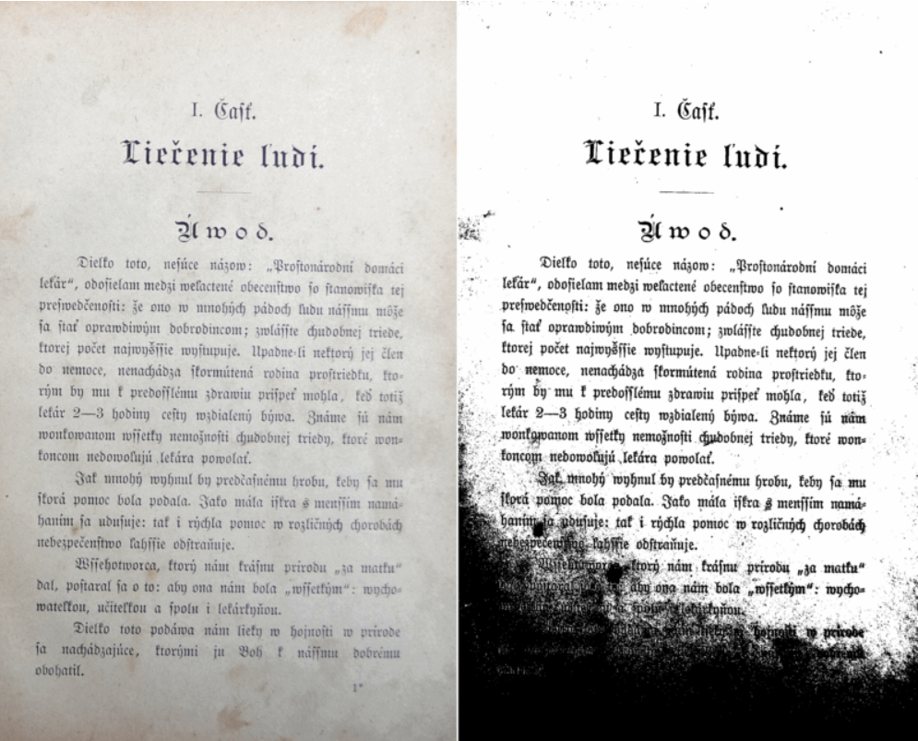
AUTOENCODERS – Example of Binarisation
Converting an image to black and white
Notes:
Source:https://tesseract-ocr.github.io/tessdoc/ImproveQuality.html

Slide 14
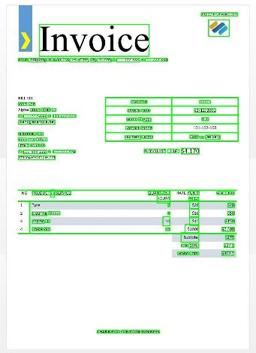
autoencoders – Dataset processing
Text Extracted from scanned Document

Slide 15
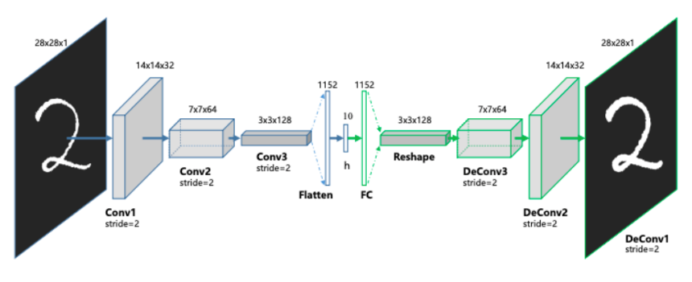
Birds’ Eye View of the Autoencoder Structure

Slide 16
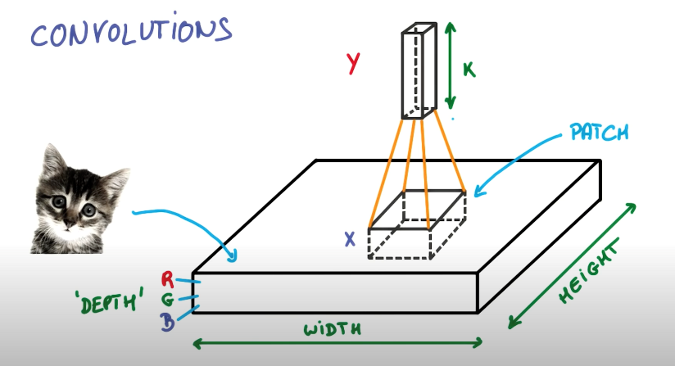
Padding:

Slide 17
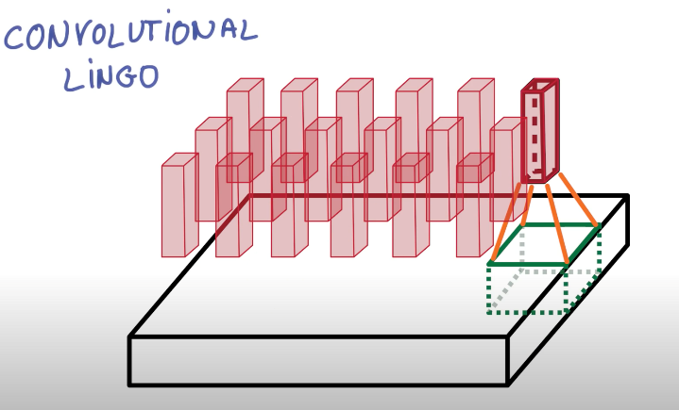
Stride:

Slide 18
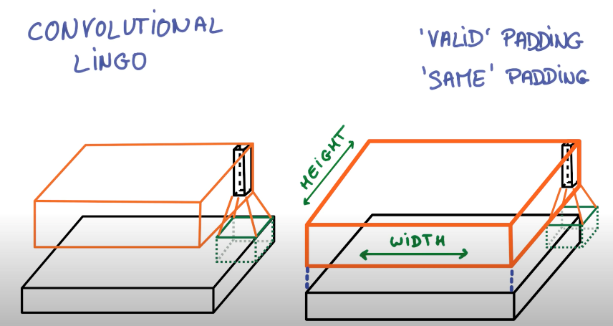
Padding:

Slide 19
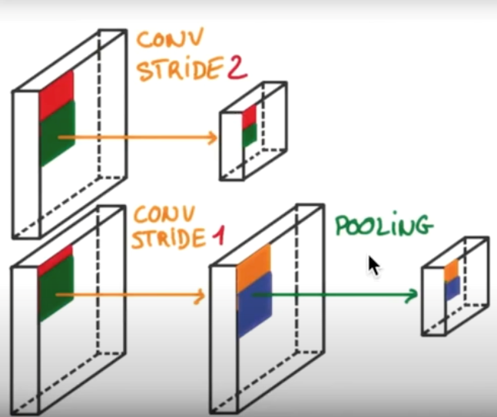
Pooling:

Slide 20
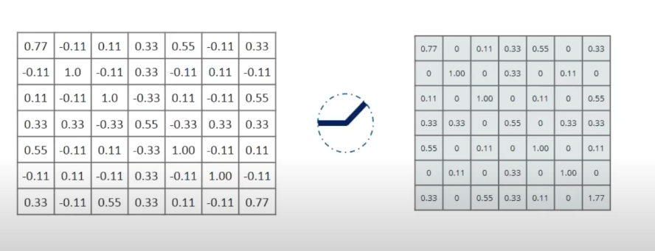
Math Behind the Scene: Relu

Slide 21
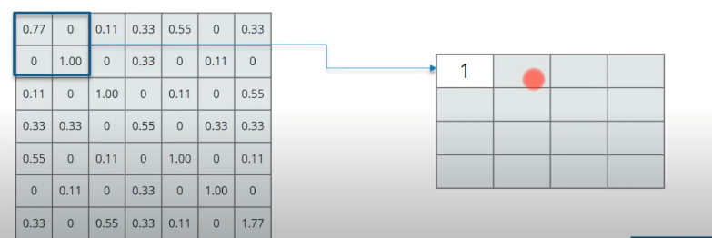
Math Behind the Scene: Maxpooling

Slide 22
[team name] – analytic/algorithm Specification
Name: Convolutional Autoencoder
How it works: Unsupervised machine learning algorithm that takes an image as input and tries to reconstruct it back using a fewer number of bits from the latent space representation.
Encoder: Conv2D and Max pooling Layers.
Decoder:Conv2D and Upsampling 2D layers
Libraries : Numpy, Tensorflow, Keras, OpenCV
Parameters: Width, height. Depth, Filter, LatentDim(Default =16)
Data Inputs: Image data in .Tiff format are converted to JPEG in Python using PIL
Hyperparameters: loss(sparse_categorical_crossentropy )
Model Tuning: Code Size, No.of Layers, Loss function(Adding penality to weight size) , holdout to validation data
Model Training Resources Required: GoogleColab (GPU)
Model Deployment: Trained model is used to improve the text quality extracted from the image.

Slide 23
[team name] – analytics/algorithms - Demonstrations
[provide a demo for each analytic/algorithm be considered]

Slide 24
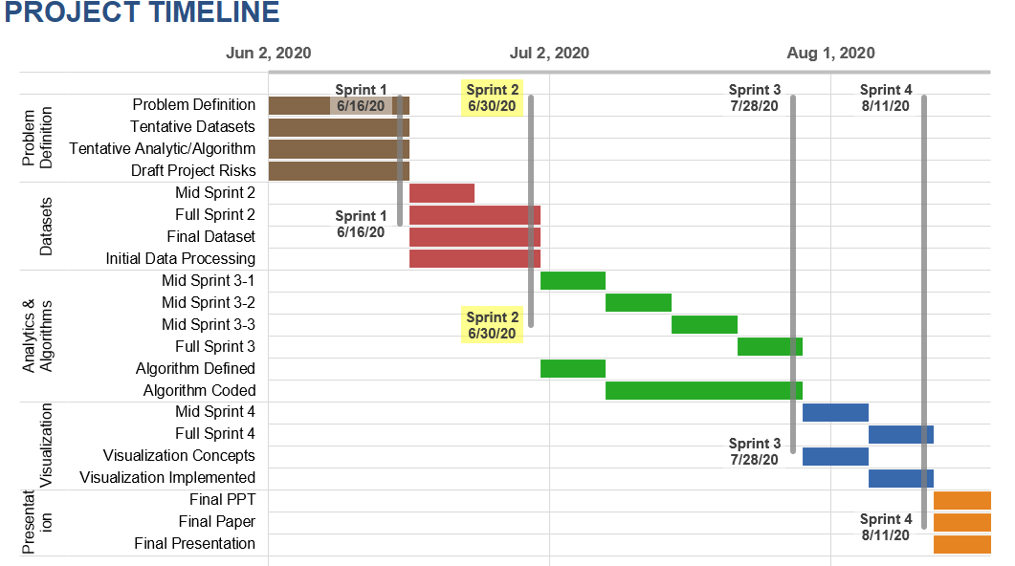
Team autoencoders– Project Schedule

Slide 25
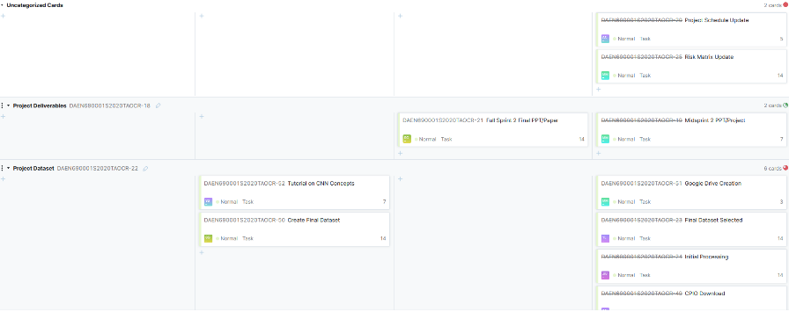
Team autoencoders – youtrack

Slide 26

Autoencoders – Risks and Planned Mitigations
Risk Name | Description | Probability | Impact | Mitigation
Inadequate data for project goal | A lack of images “noisy” enough to adequately test CNN-OCR project goal | Low | High | Promising datasets identified, composite dataset options available.
Unavailable compute resources | A lack of compute resources will leave us unable to conduct CNN training | Low | high | Alternative resources available through university and commercial means.
Inadequate internet access | Unable to access compute or communications channels | Low | High | Persistent internet outage unlikely, will seek alternate access points.
Inadequate team communications | Inability to communicate with team during work effort | Low | Low | Multiple communications channels; BB, Slack, email, phone, YouTrack
Inadequate stakeholder communications | Inability to get feedback / requirements from sponsors | Low | Low | Multiple communications channels, BB, email, phone, YouTrack.

